Slide 1
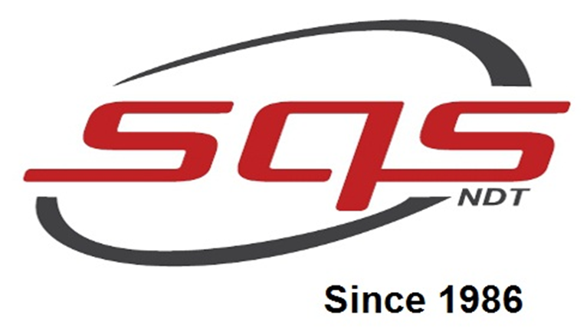
Super Quality Services
(A Successful NDT Pacesetter)

Slide 2
Overview of the company
Company was established in 1986 by our managing director Mr. TAMIL SELVAN.
The company has clients in and around the country.
Currently we are expanding business to Indonesia and Saudi Arabia.
Being a company dedicated to NDT we at SQS offer all scopes of testing and fabrication of components in our own premises.

Slide 3
Advance NDT Division Overview
Laser Shearography
Digital Image Correlation
Eddy Current Testing
Phased Array Ultrasonic Testing
Long Range Ultrasonic Testing
Betatron (7.5&10 MeV)
LINAC(9MeV)

Slide 4
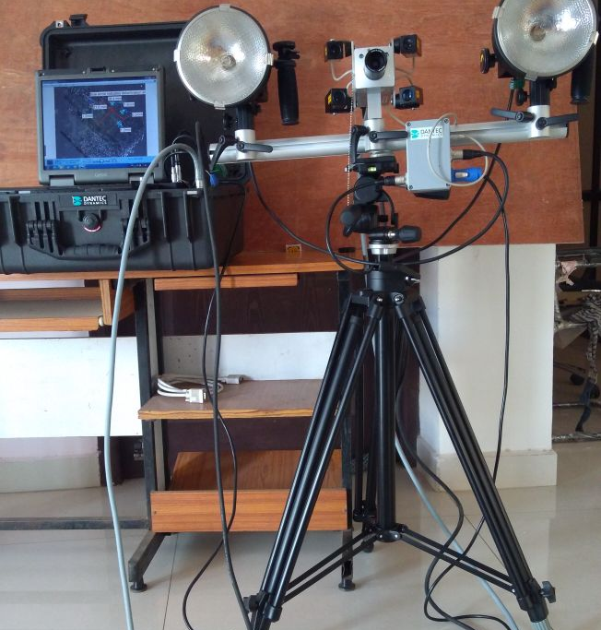
Overview of Laser Shearography

Slide 5
Laser Shearography Testing(LST)
TESTED PRODUCTS
DETECTABLE DEFECTS
Heat shield of spacecrafts
Wind mill turbine blades
Hull of high speed race boat
Complex honeycomb structure
Propellent tank
Thin Aluminium welds of aircrafts
composite overwrapped pressure vessels (COPV)
glass-fiber & fiber-metal laminates
Wrinkles
Disbonds
Delamination
Cracks
Crushed core
Kissing bonds
Fluid ingress
Cracked cores
Porosity
Voids
Foreign objects
Impact damage (BVID’s)

Slide 6
Composite Overwrapped Pressure Vessels (COPV)

Slide 7
Heat shield of spacecrafts

Slide 8
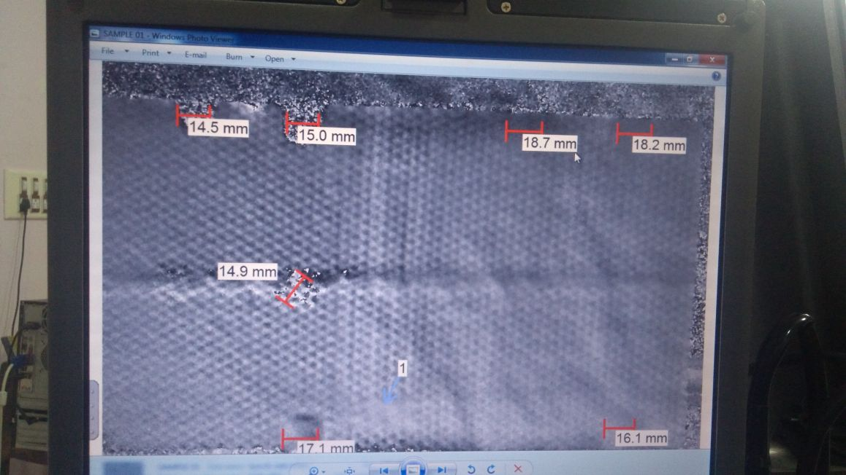
Honeycomb Structure

Slide 9
Bi-Layer CFRP

Slide 10
Summary
Optical based NDT technique identifies internal material discontinuities or anomalies in homogenous and non-homogenous materials.
Highly sensitive interferometric technique will measure microscopic surface out-of-plan deformations caused by internal flaws when a small stress is applied to the object.
Stress can be done using thermal, pressure, vibration or mechanical excitation.

